Slide 1
Discovery National Rally
Amana, Iowa
Seminar # 5 and #7
September 23rd and 24th 2015
Helpful Money Saving Tips for your Discovery
Disclaimer: Not all “D’s” are alike – not all Tips are applicable to your coach

Slide 2
Tip Number 1:
One hose is all that is needed for water into the coach.
How many water pressure valves have you forgotten at RV parks?
Constructed using 90 degree brass fittings and standard ¾ inch PVC pipe
2 brass 90 degree fittings connected to black and fresh water connections
2 valve connections for input water supplies
1 check valve installed on black water line
Brass adjustable water pressure PSI valve with meter installed inside coach
4 foot flexible water hose installed as primary connection point
Total cost – approximately $ 89.00 ($65 for pressure valve)

Slide 4
Tip Number 1 (cont.):
Parts needed:
2 – 90 degree threaded brass connectors
3 - ¾ inch male threaded to smooth connectors
4 - ¾ inch PVC pipes – 3 inches long (smooth on both ends)
2 – ¾ inch PVC valves (smooth)
1 – ¾ inch check valve (smooth)
1 – ¾ inch PVC T connector (smooth)
2 – ¾ inch PVC 90 degree pipe (smooth)
2 - ¾ inch PVC pipe – each approx. 1 foot long
1 – ¾ inch PVC pipe extension
1 – Brass adjustable PSI water pressure valve with meter

Slide 5
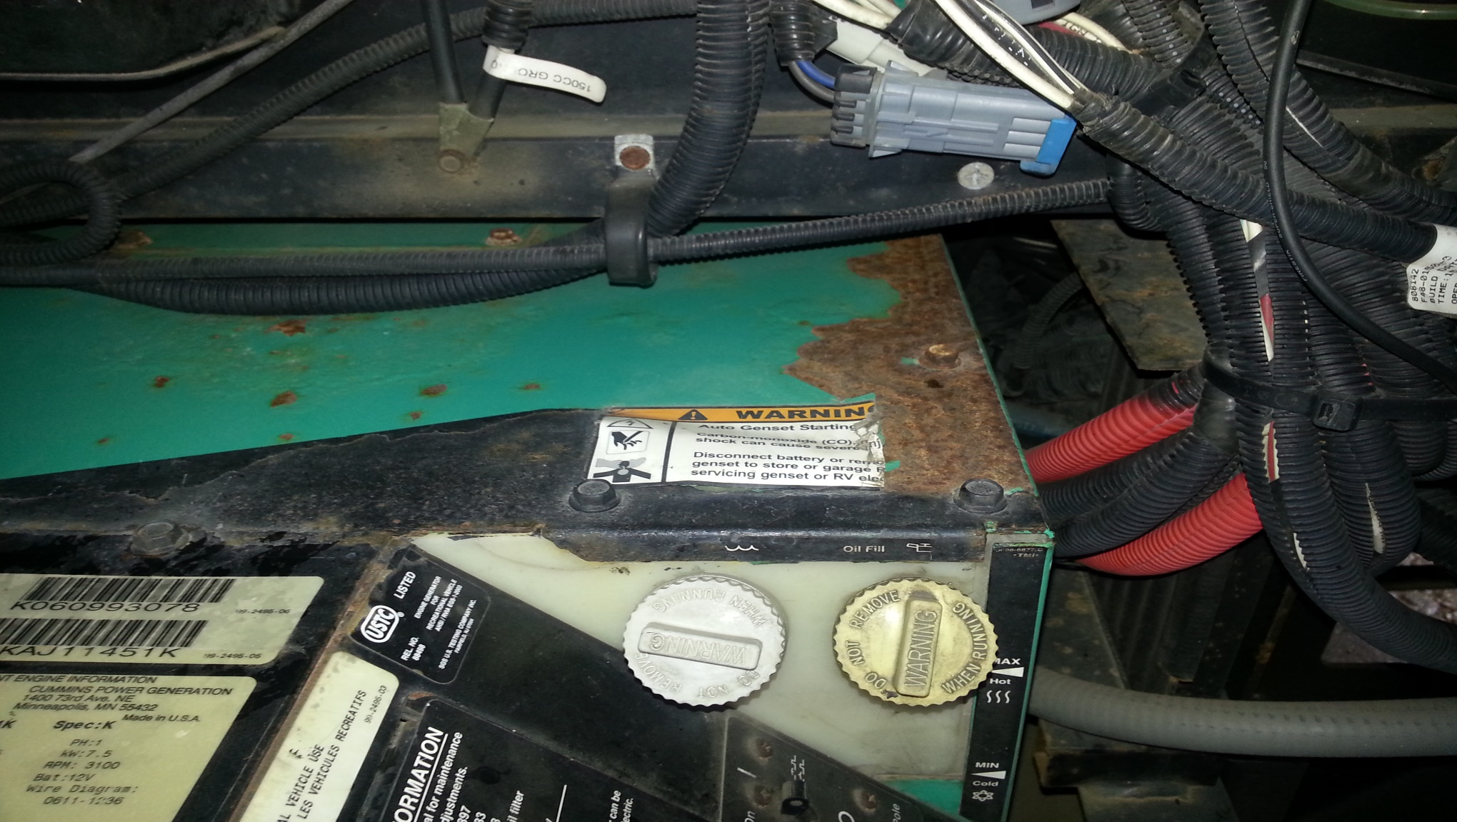
Tip Number 2:
What causes this?

Slide 6
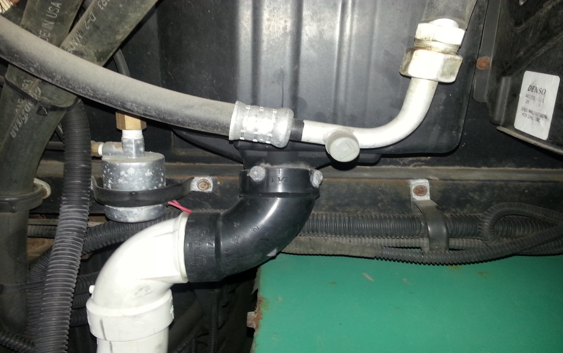
Tip Number 2 (cont.):
Damage to Generator due to location of dash AC condensation drain

Slide 7
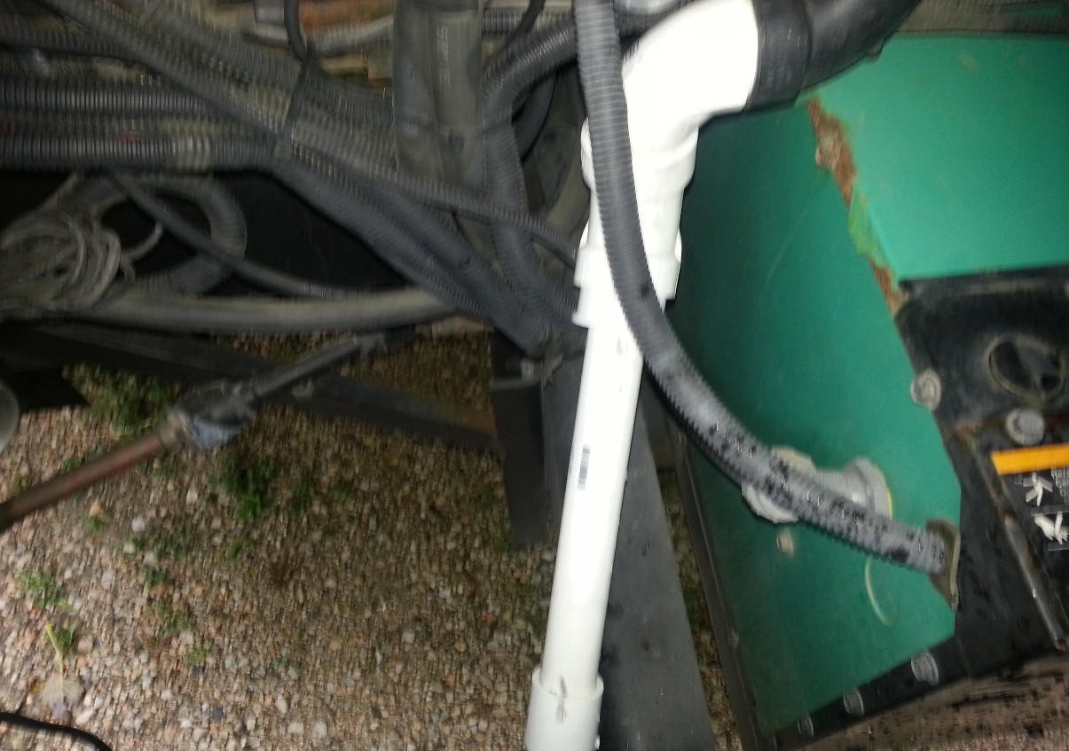
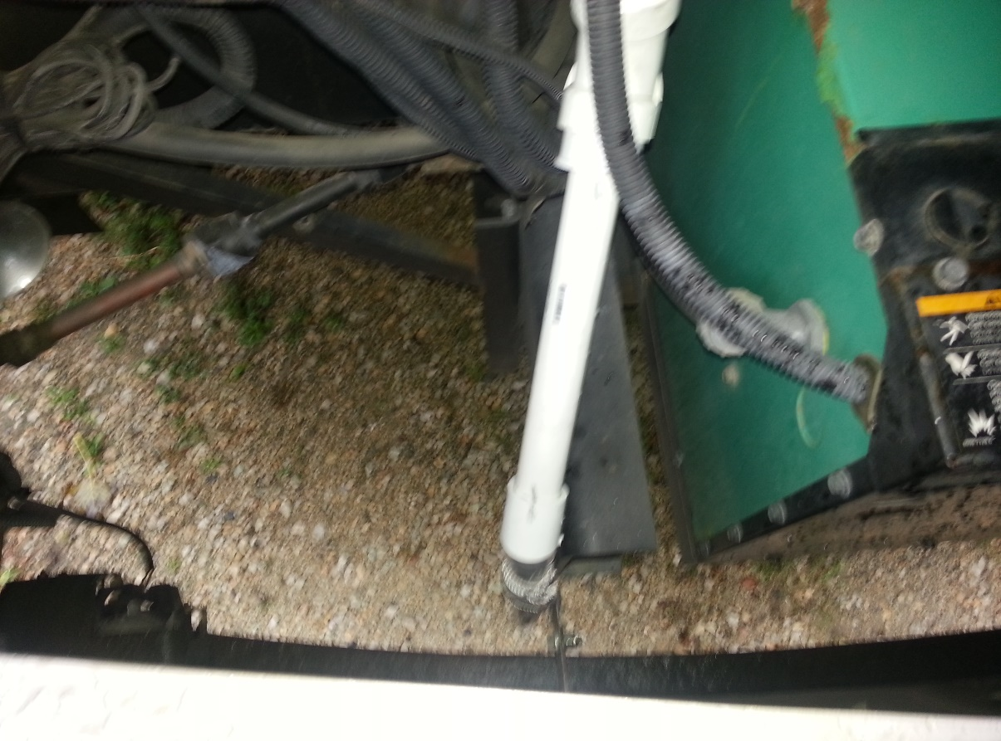
Tip Number 2 (cont.):
Drain line made of PVC (white) redirects water to ground
PVC parts cost was minimal – approximately $6.00 total cost

Slide 8
Tip Number 3:
Lack of efficient AC cold air distribution
On “most” Discovery models, AC duct work runs entire length of coach
No separation of duct work between AC units
Cold air distributed by AC unit #1 in front of coach can be felt coming out of last vents in the very back of the coach
Cold air distributed by AC unit #2 in back of coach can be felt coming out of the first vents in the very front of the coach
VERY POOR INSULATION PERFORMED WHEN AC UNITS WERE INITIALLY INSTALLED AT THE FACTORY.
Too much cold air lost exiting the AC unit that is redirected from the output damper, to the input damper on each unit.
½ roll of AC silver tape fixes 90% of cold air loss in unit.
3 cent fix improves air distribution and increases air flow to each section of the coach

Slide 9
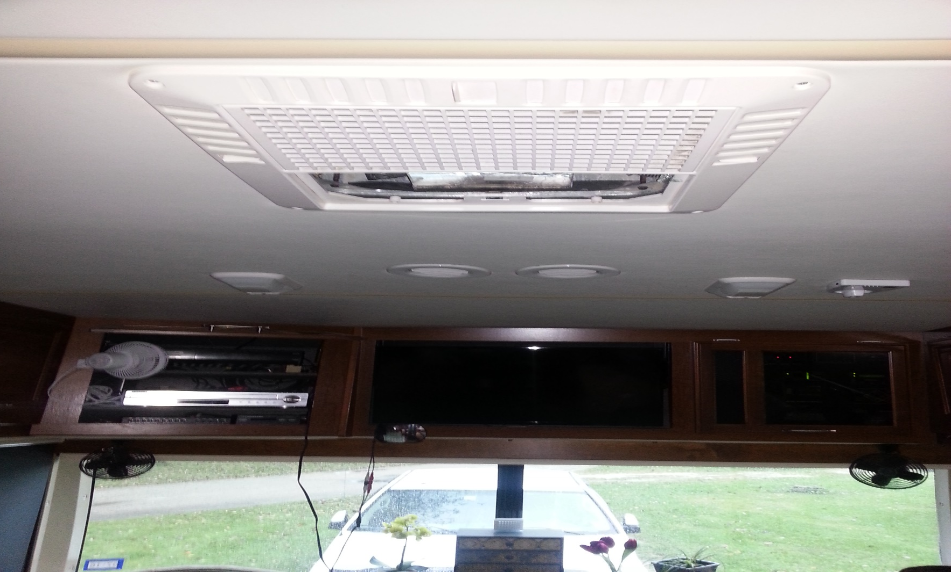
Tip Number 3 (cont.):
“Chiller Grill” installed under each AC unit
Approximate cost - $89.00 for each grill
Most Discovery models have one as standard equipment in the front

Slide 10
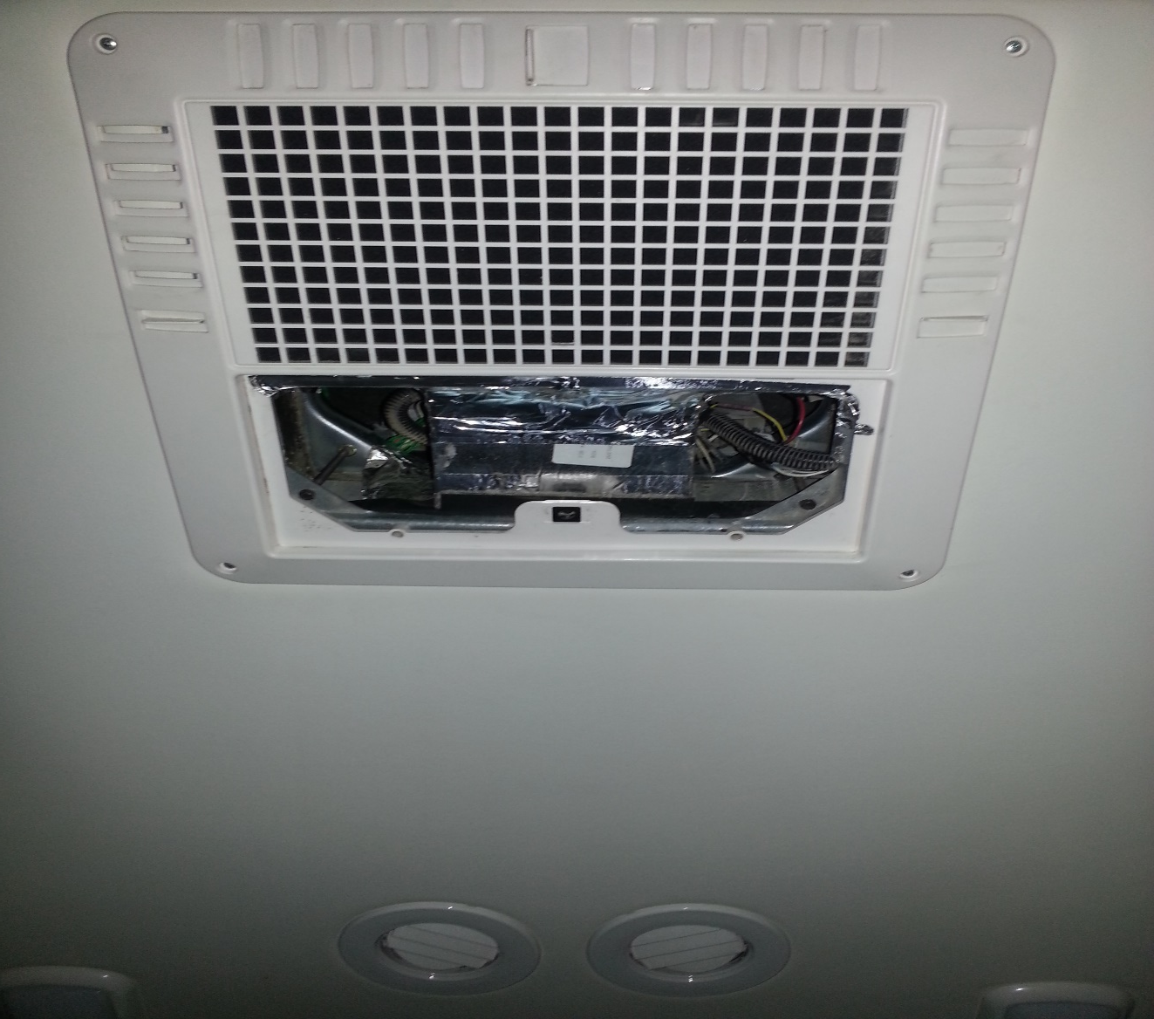
Tip Number 3 (cont.):
Installation of silver tape on both input & output side of AC unit
OUTPUT
INPUT

Slide 11
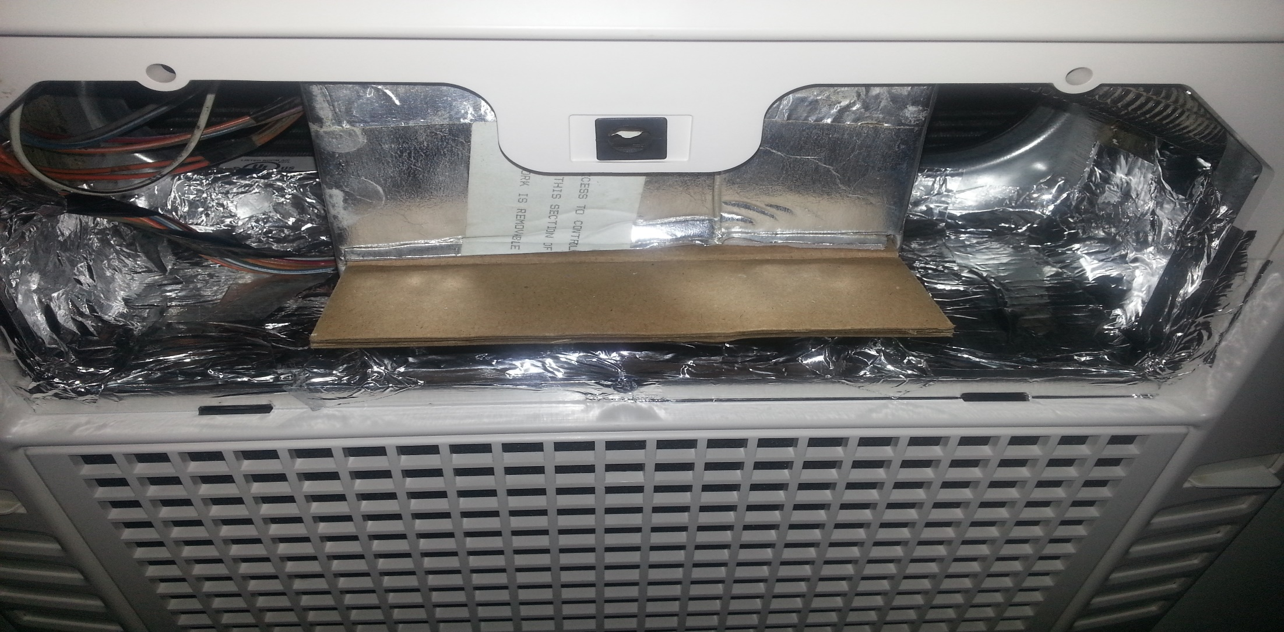
Tip Number 3 (cont.):
3 cent fix. Cardboard installed to divert airflow

Slide 12
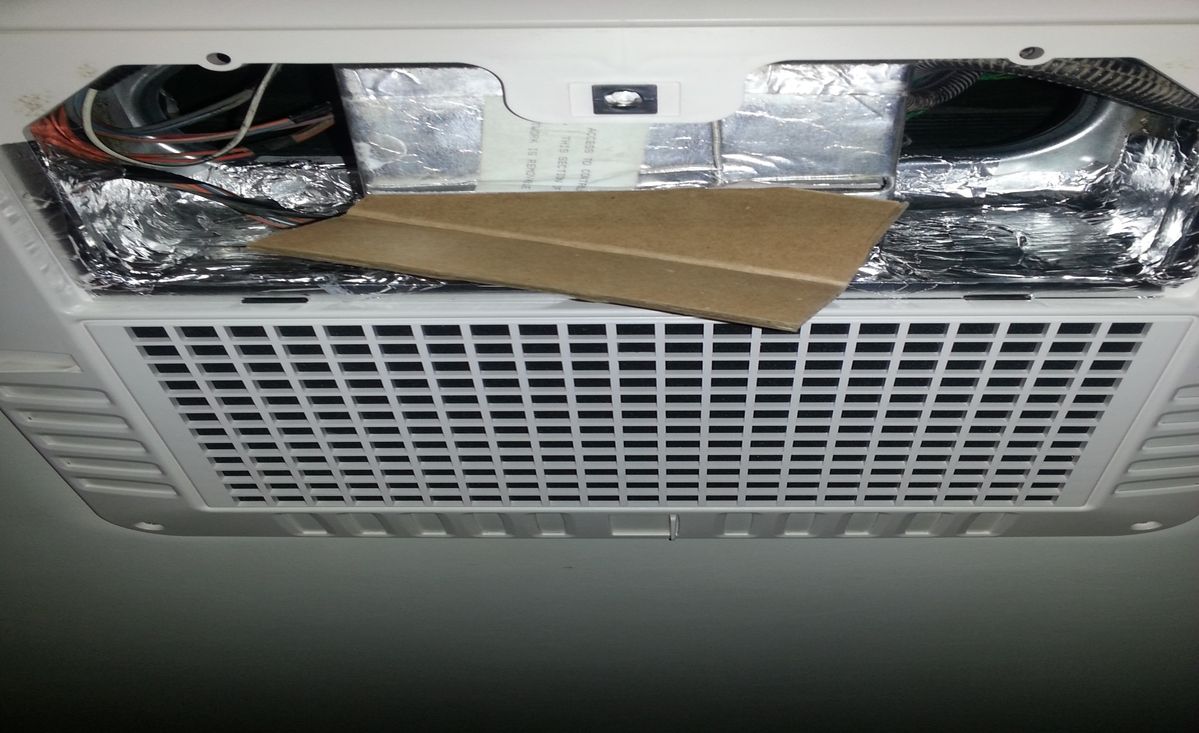
Tip Number 3 (cont.):
3 cent fix. Cardboard installed to divert airflow

Slide 13
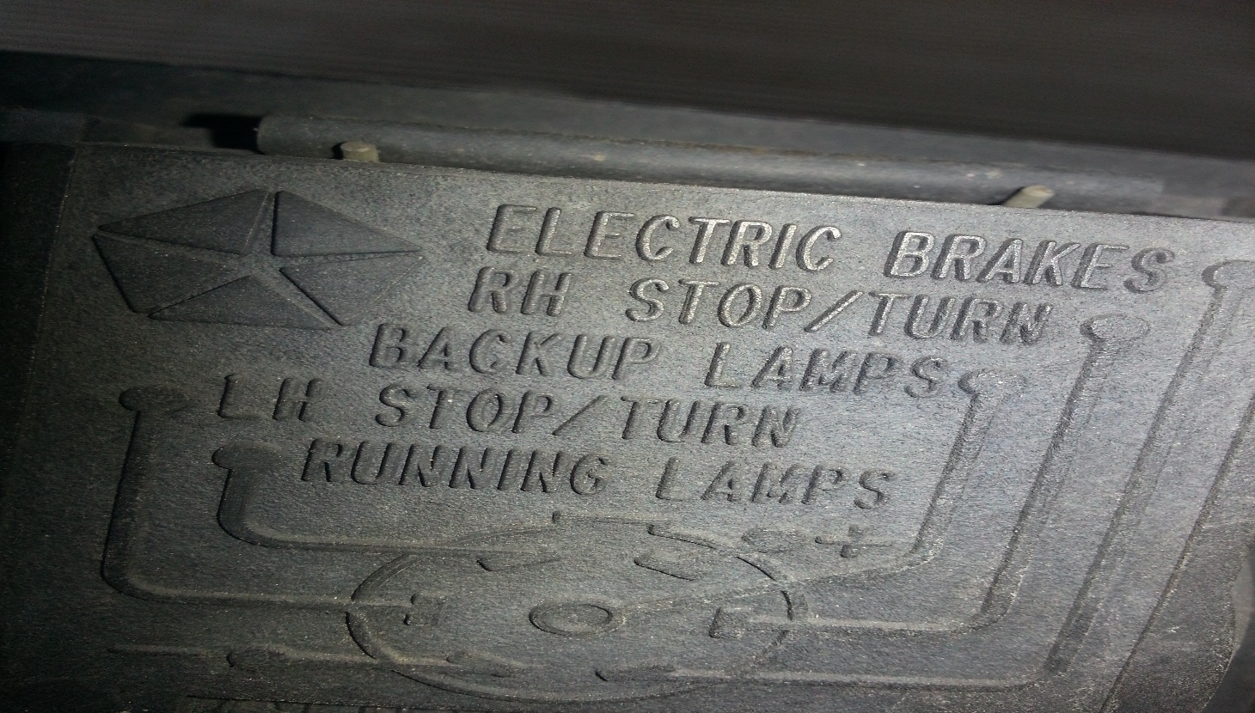
Tip Number 4:
Installation of battery charger to toad
Coach has 7 wires connected to rear plug (Shown below)
Most harnesses have only 4 wires in harness
Which 4 wires are typically already connected?

Slide 14
Tip Number 4 (cont.):
4 wires typically connected are:
RH stop/turn at 3 o’clock position
LH stop/turn at 9 o’clock position
Running Lamps at 11 o’clock position
Backup lamps ( center position)
Which 1 or 2 wires need to be added so battery charger will work?

Slide 15
Tip Number 4 (cont.):
One wire needs to be added – Power (+) at 1 o’clock position (11 o’clock on wire harness going to tow vehicle)
Why only 1 wire? Why is a ground wire not needed?

Slide 16
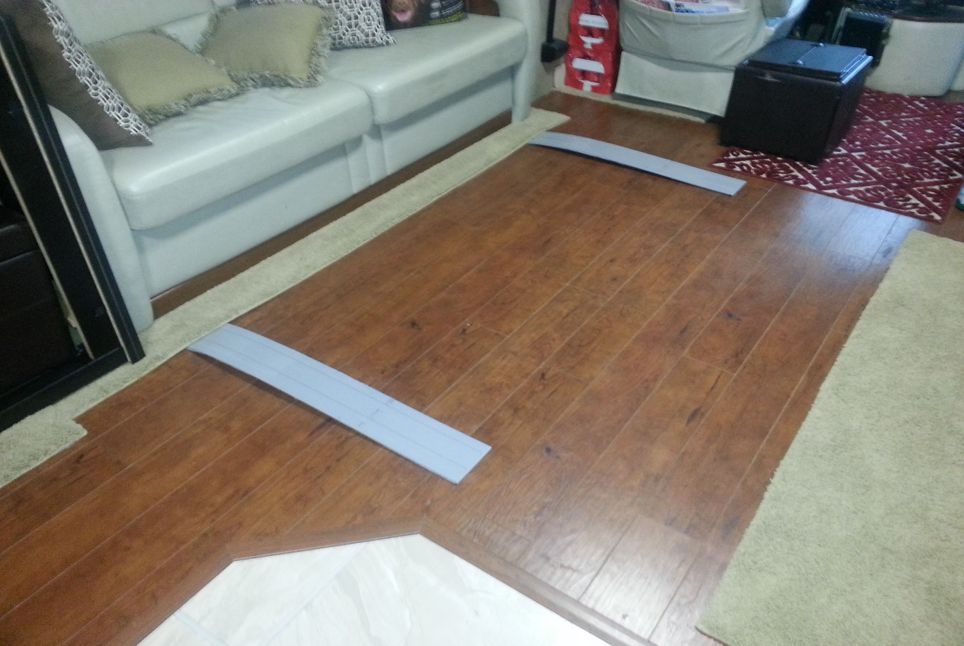
Tip Number 5:
Use of floor “Slide out Slickers” to protect wooden floors
Location of slickers is important
Installed where each roller is attached to slide out
Slicker needs to be “thinned down” to be effective
Cost – Approximately $45~$54 each; 2 to 4 needed

Slide 17
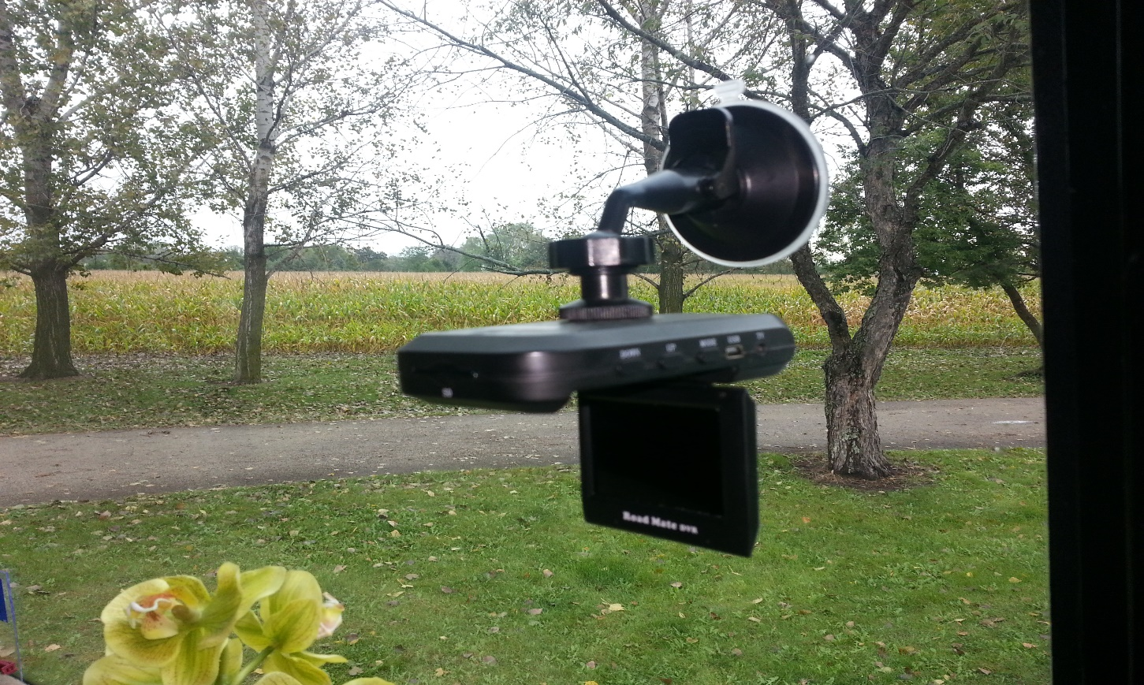
Tip Number 6:
Use of small 12v RV camera to record road in front of you while driving
Excellent “proof” in case of an accident
Very cost effective – Cost is generally around $125.00
Save at least this much when proof is needed for insurance purposes
Road Mate Model 7202 – RoadmateDVR.com

Slide 18
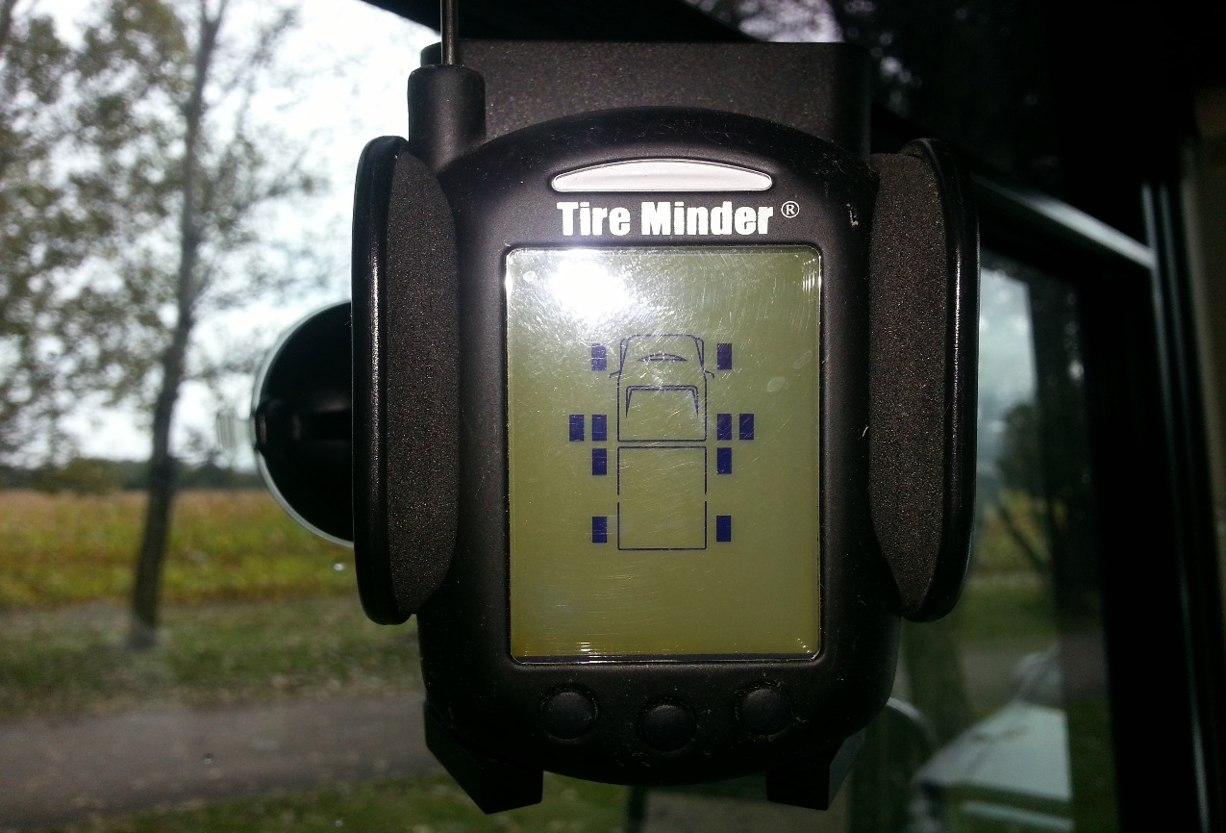
Tip Number 7:
Tire Pressure Monitoring System (TPMS)
Almost a necessity if you tow a vehicle.
Can be expensive at $400+
Numerous systems available with many Pro’s/Con’s

Slide 19
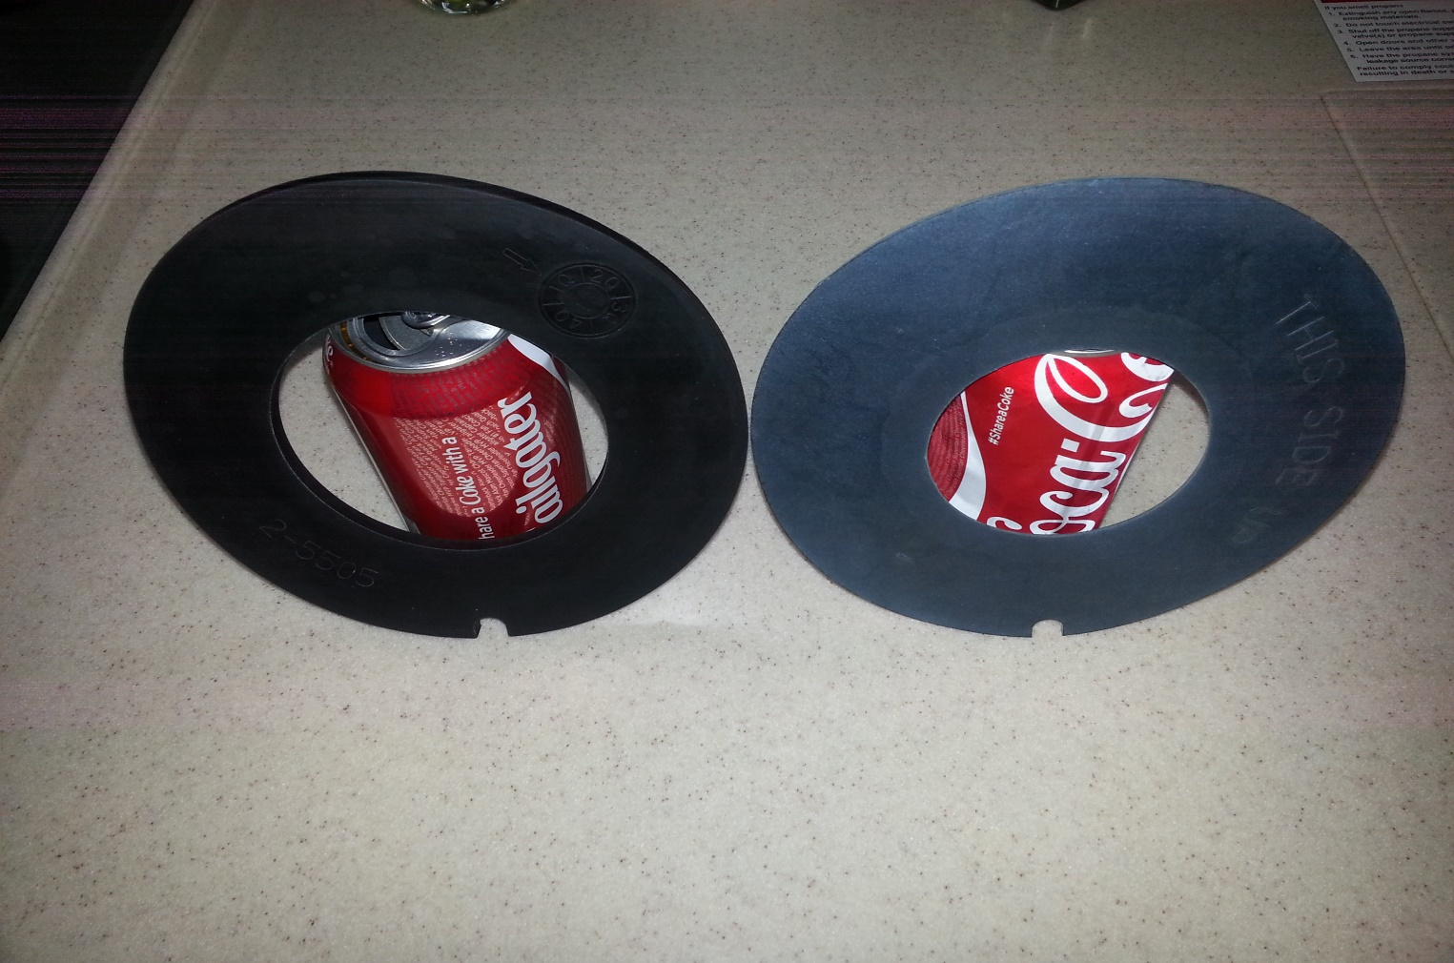
Tip Number 8:
What is it, and where is it used
Hint: NEVER Lubricate
P/N 385311462

Slide 20
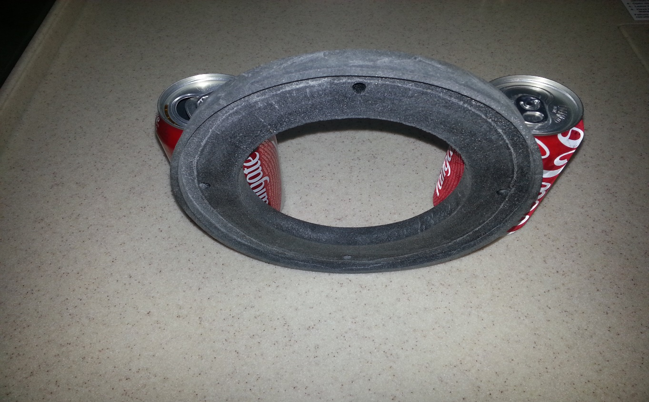
Tip Number 9:
What is it, and where is it used
Make sure you have the right part for your coach
Fits a Sealand Model 101 or 102
P/N 385311267

Slide 21
Tip Number 10:
You ever get locked out of your coach?
(Yes, it can happen – and more often than you think)
How many sets of master keys does Fleetwood make for the Discovery?
Will another Fleetwood coach key (Bounder, American Eagle, Revolution) work on a Discovery?
Where can you hide a key in your coach so you are never locked out?
How many original keys should you copy/hide? (1,2,3,4,5?)

Slide 22
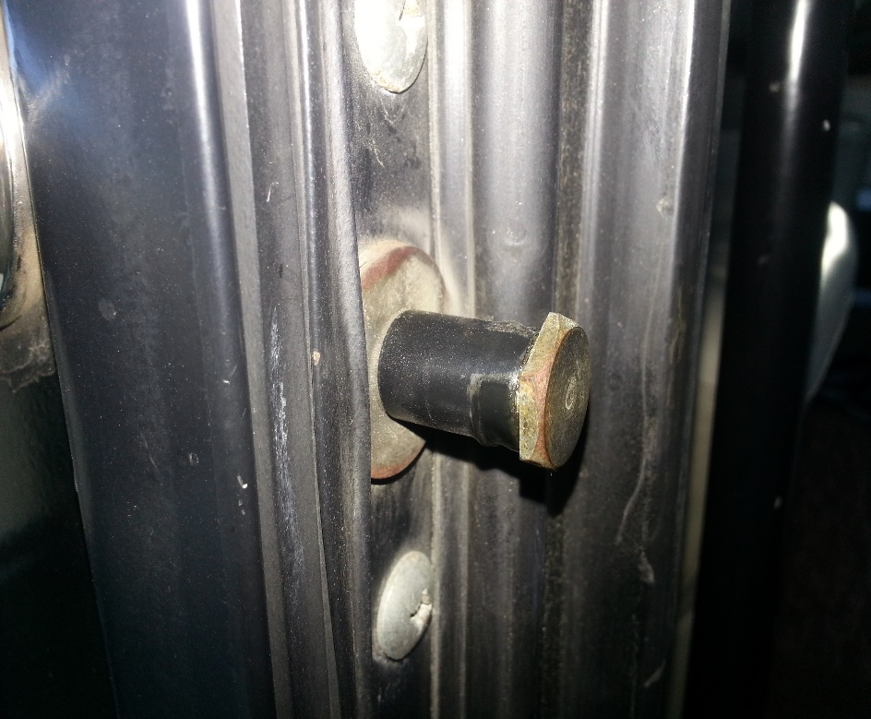
Tip Number 11:
Stop rattling noise when driving down the road
Sound appears to be coming from somewhere near the front door
1 suggestion – add electrical tape to door latch
Another – Velcro heavy plastic door to main door –check screws/insulation

Slide 23
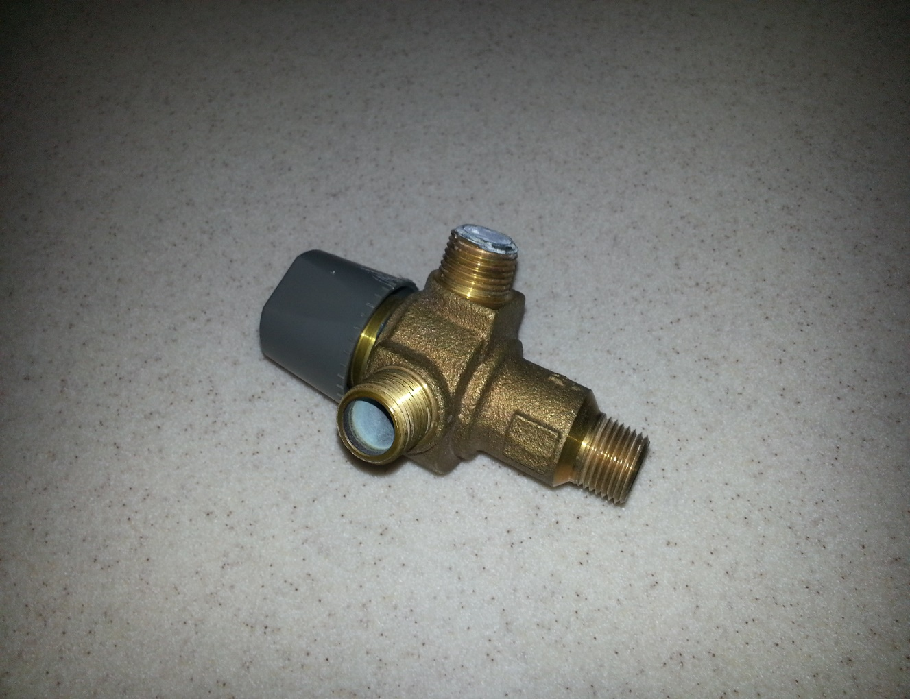
Tip Number 12:
What is it, and where is it used?
Can be expensive at $300+
Possible to fix if clogged

Slide 24
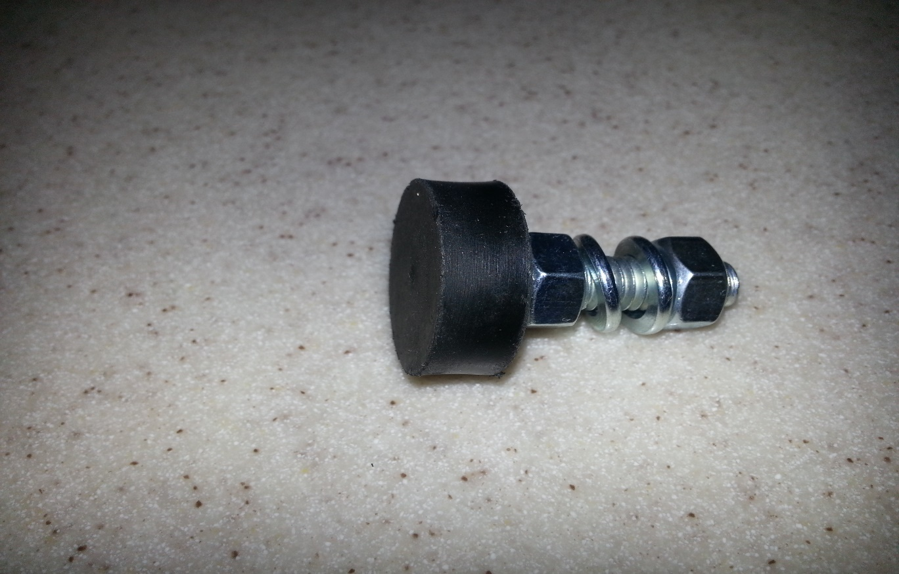
Tip Number 13:
What is it, and where is it used?
Can be used in two different locations, for two different parts of the coach
Can be expensive at $6.03 each – 2 or 4 needed at each location
Nuts and lock washers not included in price

Slide 25
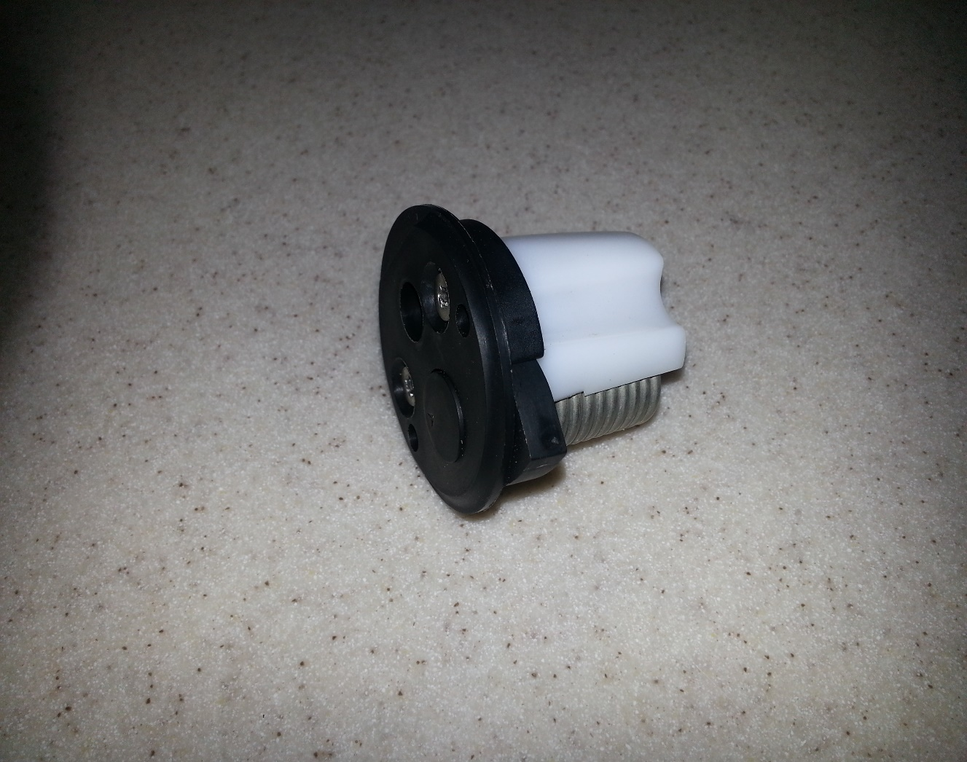
Tip Number 14:
What is it, where is it used, and WHY would you NEVER/EVER want to replace it unless it is totally inoperative?

Slide 26
Tip Number 15:
Weep hole covers – Don’t tape over them

Slide 27
Tip Number 15:
Weep hole covers – Don’t tape over them
Tip Number 16:
Contrary to what people think or say, 2-12 volt batteries are NOT better than 4-6 volt deep cycle batteries.

Slide 28
Tip Number 15:
Weep hole covers – Don’t tape over them
Tip Number 16:
Contrary to what people think or say, 2-12 volt batteries are NOT better than 4-6 volt deep cycle batteries.
Tip Number 17:
Do not use the spotlight to shine on your flag at night – Why?

Slide 29
Tip Number 15:
Weep hole covers – Don’t tape over them
Tip Number 16:
Contrary to what people think or say, 2-12 volt batteries are NOT better than 4-6 volt deep cycle batteries.
Tip Number 17:
Do not use the spotlight to shine on your flag at night – Why?
Tip Number 18:
Entry step motor – keep a spare pinion pin and cotter pin beware if you have to replace the motor or gear box. Mounting bolts not secured

Slide 30
Tip Number 15:
Weep hole covers – Don’t tape over them
Tip Number 16:
Contrary to what people think or say, 2-12 volt batteries are NOT better than 4-6 volt deep cycle batteries.
Tip Number 17:
Do not use the spotlight to shine on your flag at night – Why?
Tip Number 18:
Entry step motor – keep a spare pinion pin and cotter pin. Beware if you have to replace the motor or gear box. Mounting bolts not secured to frame
Tip Number 19:
300 amp fuse inline between batteries and coach circuits. Rarely bad, but impossible to find locally

Slide 31
Tip Number 20:
Trico Heavy duty metal twin screw adapter for windshield wipers
Part number B98999-146

Slide 32
Tip Number 20:
Trico Heavy duty metal twin screw adapter for windshield wipers
Part number B98999-146
Tip Number 21:
Drawer latches
Three sizes – Small drawer, 5 pound pull and 10 pound pull.
Contact Southco.com

Slide 33
Tip Number 20:
Trico Heavy duty metal twin screw adapter for windshield wipers
Part number B98999-146
Tip Number 21:
Drawer latches
Three sizes – Small drawer, 5 pound pull and 10 pound pull.
Contact Southco.com
Tip Number 22:
Hard to find cabinet handles, LED Grab bars, Plastic vent covers, Light fixtures, wall sconces, dashboard switches, etc. Contact Ickes RV Surplus Supply, Inc. 701 West Huntington St. Montpelier, In. (765) 728-5668

